Slide 1


Central Limit Theorem

Slide 2

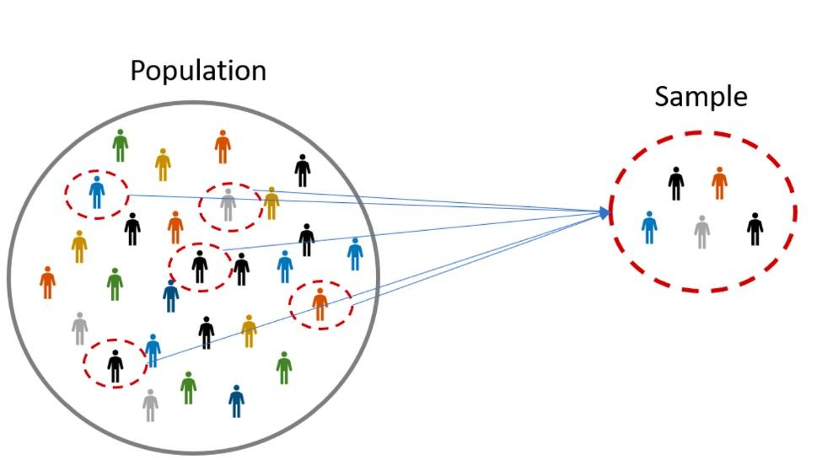



Central Limit Theorem
Imagine that you take samples from a population of people’s heights, and for each sample you calculate their mean.

Slide 3
Central Limit Theorem
μ1 = 10
μ1 = 12
μ1 = 9
μ1 = 10
μ1 = 6
μ1 = 12
μ1 = 10
μ1 = 11
μ1 = 11
μ1 = 13
μ1 = 19

Slide 4
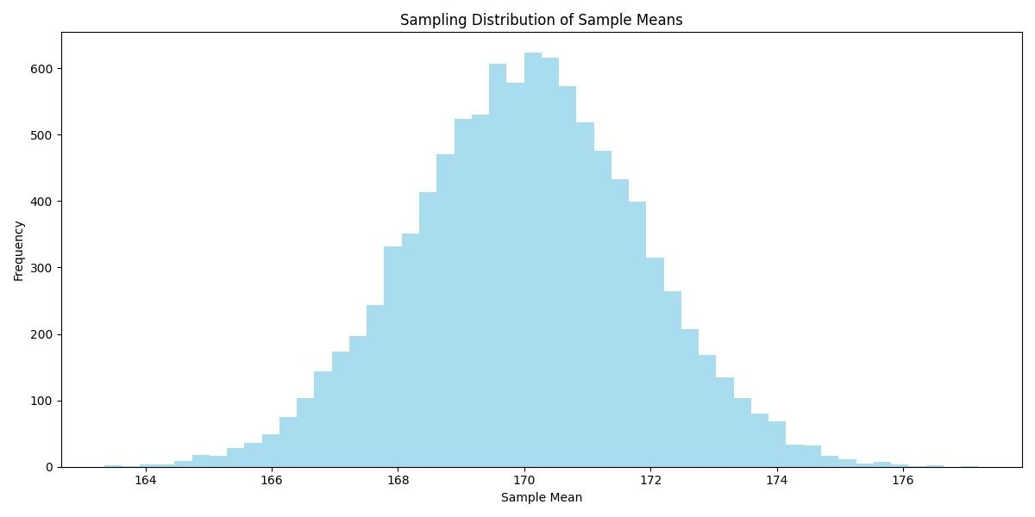
Central Limit Theorem
μ1 = 10
μ1 = 12
μ1 = 9
μ1 = 10
...
...
μ1 = 13
μ1 = 18
μ1 = 19
μ1 = 5
μ1 = 20

Slide 5
Central Limit Theorem
Now, if we plot all sample means, we get a familiar shape, a normal distribution. In other words, the distribution of the means of the sampling distribution tends towards a normal distribution.

Slide 6
Central Limit Theorem
The sampling distribution will consistently tend toward a normal distribution, having its own mean and standard deviation. An essential takeaway is that the mean of the sampling distribution equals the population mean. This is happens regardless of the shape of the population distribution.

Slide 7
Central Limit Theorem
The Central Limit Theorem (CLT) states that, irrespective of the shape of the underlying population, the sampling distribution of the mean will approximate a normal distribution as the sample size grows larger (n > 30), assuming all samples are identical in size and randomly sampled.
Large Sample Size & Individual Data Points: Even with a large sample, the distribution of individual data points could still be non-normal. For instance, a dataset with millions of data points could exhibit significant skewness or extreme kurtosis.
Large Sample Size & Averages of Samples: If you are taking multiple samples from a population and calculating their averages, the distribution of those averages tends to be normal due to the CLT, even if the underlying population is not normal.
Practical Implications: While the CLT is powerful, it's important to remember that many statistical tests and methods assume that the individual data points (not their means) follow a normal distribution. Therefore, having a large dataset doesn't allow you to bypass these assumptions.

Slide 8
Check if Data is Normally Distributed

Slide 9

Normal Distribution
Checking if data is normally distributed
Visual Inspection:
Histogram: A bell-shaped curve in a histogram is indicative of a normal distribution.
Q-Q Plot: In this plot, the quantiles of your data are plotted against the quantiles of a normal distribution. If the data is normally distributed, the points should roughly lie on the y=x line.
Box Plots: The symmetry of a box plot can give hints about data normality.
Statistical Tests:
Shapiro-Wilk Test: This is a popular test for normality. A low p-value (typically p<0.05) indicates that the data is not normally distributed.
Kolmogorov-Smirnov Test: This test compares the cumulative distribution of your data to a normal distribution. Again, a low p-value suggests non-normality.
Descriptive Statistics:
Skewness and Kurtosis: Skewness measures the asymmetry of the data distribution, while kurtosis measures the "tailedness". For a normal distribution, skewness should be close to 0 (indicating symmetry), and kurtosis should be close to 3. Should be used in conjunction with other methods.

Slide 10
Normal Distribution
Transforming Data to Be Normally Distributed
Transforming data to be approximately normal can aid in statistical analysis and modeling.
Log Transformation:
Useful for data that shows exponential growth, like population or financial data.
Use when data is right-skewed.
Square Root Transformation:
Moderates the impact of extreme values.
Suitable for data with mild skewness.
Box-Cox Transformation:
Requires positive data values.
Automatically determines the best power transformation.

Slide 11
Normal Distribution
Transforming Data to Be Normally Distributed
After Transformation:
Re-assess Distribution: After applying a transformation, visually assess the distribution again using histograms and Q-Q plots.
Statistical Testing: Shapiro-Wilk or Kolmogorov-Smirnov tests can be used to statistically assess normality.
Remember to reverse transformations (when needed) for interpretation.
Always consider the underlying reasons for any non-normality, as transformations might not always be the best solution.

Slide 12
Normal Distribution
Central Limit Theorem
The CLT states that, regardless of the shape of the underlying population, the sampling distribution of the mean will approximate a normal distribution as the sample size grows larger (n > 30), assuming all samples are identical in size and are randomly sampled.
1. Large Sample Size & Individual Data Points: Even with a large sample, the distribution of individual data points could still be non-normal. For instance, a dataset with millions of data points could still be heavily skewed or have extreme kurtosis.
2. Large Sample Size & Averages of Samples: If you're taking multiple samples from a population and calculating their averages, the distribution of those averages tends to be normal due to the CLT, even if the underlying population is not normal.
3. Practical Implications: While the CLT is powerful, remember that many statistical tests and methods assume that the individual data points (not their means) are normally distributed. So, you can't bypass these assumptions simply because you have a large dataset.

Slide 13
To be
Continued…

